Slide 1
EMS Interoperability Workshop
August 22, 2023

Slide 2
Time | Topic | Facilitator
12:00-12:15 | Interoperability Showcase Videos
12:15-12:30 | Welcome & Introductions | Josh Legler
12:30-1:30 | From Silos to Synergy: Revolutionizing Healthcare Interoperability with FHIR | Amber Weeks, Interoperability Institute
1:30-1:45 | Break
1:45-2:30 | Getting to IHE USA Connectathon 2024 and HIMSS24 IO Showcase | Amit Trivedi, IHE USA
2:30-3:00 | Current IO Landscape and Accomplishments | Josh Legler
3:00-3:15 | Break
3:15-3:45 | 2024 Collaboration | Josh Legler
3:45-4:00 | Your Next Steps | Josh Legler
Notes:
Before or after presenting the agenda
Introduce Amit Trivedi and Amber Weeks
Have participants introduce themselves and what outcome they want from this workshop

Slide 3
From Silos to Synergy: Revolutionizing Healthcare Interoperability with FHIR
Amber Weeks
Interoperability Institute

Slide 4
Break

Slide 5
Getting to IHE North American Connectathon 2024 and HIMSS24 Interoperability Showcase
Amit Trivedi, MS
HIMSS & IHE USA

Slide 6
Today we will cover…
Connectathon 2024
Interoperability Showcase™ @ HIMSS24
Interoperability – Next Steps

Slide 7
Our Vision
Improving the quality, value, and safety of healthcare by enabling rapid, scalable, and secure access to health information at the point of care.
Our Mission
IHE USA improves our nation's healthcare by promoting the adoption and use of IHE and other world-class standards, tools, and services for interoperability.

Slide 8
Role of IHE USA
Testing & Conformity Assessment
IHE Connectathons and IHE Conformity Assessment programs offer unparalleled opportunities for interoperability testing and assures healthcare providers that products are truly interoperable
Education
IHE USA offers educational and networking events with a special focus on interoperability and advancing health information exchange
IHE USA Interoperability For Dummies, IHE Edition provides practical advice for understanding healthcare interoperability
Leadership
Convenes key stakeholders in the US, including on-going and active engagement with the Office of the National Coordinator (ONC), government health agencies (i.e. OPA, CDC), Health Information Exchanges (HIEs), Standard Development Organizations (SDO), and other key stakeholders. Offers public comment as relevant.
Notes:
IHE Profiles for Information Exchange: https://www.iheusa.org/node/123

Slide 9


Standards Development Cycle
Development
Deployment
Call for Proposals
Months 1-3
Drafting & Publication
Months 4-14
Testing & Certification
Months 15-18
Deployment
Ongoing
IHE Call for Proposals
Profile Selection by Committees
IHE Technical Framework Development
Published for Public Comment
Trial Implementation Posted
IHE Connectathon Testing Event
Connectathon Product Registry published
Demonstrate at HIMSS Global Conference Interoperability Showcase
Deploy globally
Notes:
Each domain follows its own development schedule, some are aligned (ITI, PCC, QRPH)

Slide 10
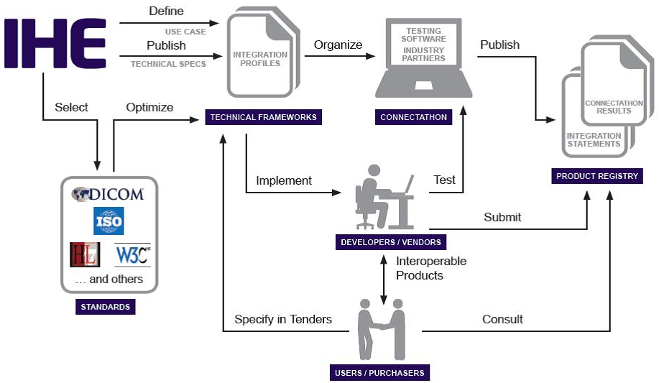
IHE Processes Translate User Needs into freely available, industry supported Technical Frameworks
Implementers are supported by global interoperability testing events focused on market suppliers and system developers

Slide 11


Path to Production
IHE USA’s Path to Production Series is a use case-focused digital event where healthcare-focused organizations at all levels of maturity can learn more about key interoperability challenges and how to deploy interoperability leveraging existing standards and technologies.
Notes:
Path to Production provides the support for groups looking to deploy standards-based interoperability solutions

Slide 12

A Closer Look
at the Moving Parts that Make Interoperability Happen:
Who all needs to be involved?
What makes health data move?
Where are we getting stuck?
What don’t we know?
What are practical next steps that can be taken today?
Interoperability is more than technology!
Notes:
Prioritize high value and health outcome use cases
Identify key stakeholder representation
Examine critical barriers and challenges
Align supportive resources
Provide a forum for discussion & decisions
Publish key learnings
Enable a platform to innovate

Slide 13




IHE USA’s Path to Production Series
Practical Implementation Guidance to Make Actionable Progress
The Path to Production by IHE USA convenes diverse stakeholders focused on the “Art of the Possible:” accelerating production level interoperable health exchange.
Supporting the deployment of interoperable solutions to support care by providing a shared, stable, and structured environment to systemically advance practical interoperability of health IT products and policies.
Connecting Implementers and Developers with Policy, Analytics, and Interoperability Experts to develop better solutions for patients and care givers, faster.
Bimonthly, Half Day Events
Interactive & On-Demand Education
HIMSS and other Industry SMEs
Accessible Information
Notes:
The path to production series is to help healthcare stakeholders achieve their interoperability goals through sharing practical, step-by-step implementation guidance so they can make actionable progress on discrete interoperability use cases.
This bi-monthly digital event brings together healthcare-focused organizations at all levels of maturity to learn more about key interoperability challenges, the vast array of developer tools and resources available, and how to deploy interoperability using existing and emerging standards and profiles.
Designed to fit into your workday and workload, IHE USA’s Path to Production digital series will connect you with the people, processes, and technology needed to progress your standards adoption project. With lots of support along the way, and a model driven around accessibility to information, IHE USA’s Path to Production engages you throughout the year with education, activities, and expertise designed to help you achieve your discrete interoperability improvement goals.
No matter where your organization is on the journey to standards-based interoperability, IHE’s Path to Production can provide you with opportunities for collective problem solving, free interoperability global goods resource development, and guidance on effectively deploying real-world digital health solutions. The Path to Production team will work with you to leverage collective resources, pull in the key stakeholders you need to achieve success, help align projects, funding opportunities, and more to support your interoperability initiatives.
Join with us on the path to production as we work together to move your organization’s interoperability goals forward and bridge the existing classical interoperability infrastructure to a world of open-API-and-FHIR®-driven health information exchange from problem identification to implementing practical solutions.

Slide 14
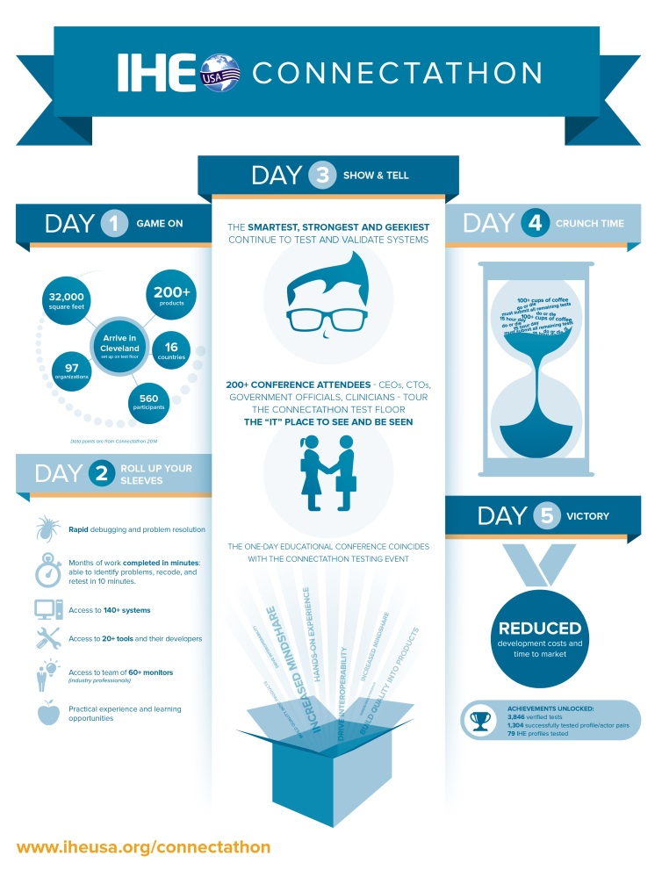
IHE NA Connectathon
Five intense days of interoperability testing and mindshare
Peer-to Peer testing is live, structured, and supervised
Industry competitors collaborate in a neutral testing environment
Testing is overseen by IHE’s technical management team & trained industry professionals
World class education and networking
Notes:
What to expect at the Connectathon:
Advancing Interoperability progress via real-world testing IHE profiles and FHIR Implementation Guides.
Attacking data exchange challenges via global and local collaboration.
Accelerating standards deployment by sharing global goods: digital health tools, content, services.
Experience interoperability in action: leveraging existing technology, with a glimpse of the future and the Art of the Possible.

Slide 15

Path to Production: NEMSIS
This free-to-attend digital series provides a space for community knowledge transfer, a forum for collective problem solving, and guidance on effectively deploying real-world digital health solutions.
Join us on the path as we focus on Interoperability within the Emergency Medical Services sphere with our Industry Task Force Listening Session: Advancing EMS Interoperability, a live interoperability roundtable discussion with the NEMSIS TAC and other EMS interoperability stakeholders focusing on the applicability nationwide interoperability infrastructure to EMS and other similar state health and public health interoperability efforts.

Slide 16


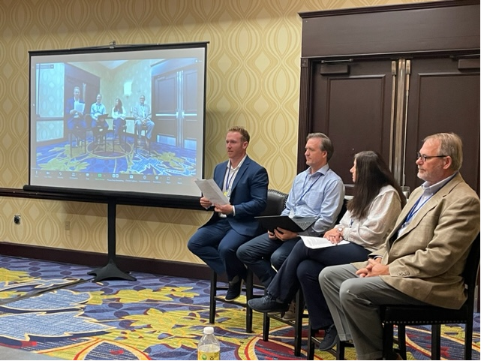
IHE North American Connectathon 2023 “The Road to Resilience”
March 6-10, 2023, in Austin, Texas
Venue: Sheraton Austin at the Capitol
March 6-10: IHE Profile Testing
March 7: IHE Experience Day & Networking Reception
March 8: Standards Acceleration Workshops
Session 1: IHE Ecosystem
Session 2: Interoperability Institute/MELD
March 9: Standards Acceleration
Session 1: SMILE Digital Health
Session 2: Drummond Group
EMS Interoperability Task Force

Slide 17
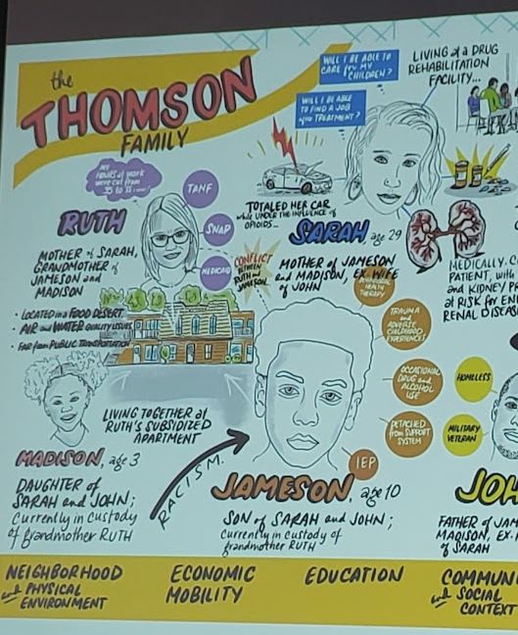
IHE Experience Day
International Patient Summary Panel:
James Agnew- CTO, SMILE Digital Health
Jurgen Brandstatter - Deputy co-chair, IHE Europe
Christina Caraballo - President, IHE USA; Vice President, Informatics, HIMSS
Dan Vreeman - Chief Standards Officer, HL7 International
ONC Update: Ryan Argentieri- ONC
TEFCA and National Networks: Didi Davis- Sequoia Project
Advancing eConsent for Social Care: Brian Handspicker- Stewards Of Change
IHE USA and NEMSIS EMS Interoperability: Josh Legler, Clay Mann – NEMSIS
PULSE System Live Demonstration: Eric Heflin- THSA
Connectathon Floor Tour

Slide 18




Implementation Acceleration Workshops
March 8, 2023
March 9, 2023

Slide 19








Testing and Tooling Summit IV

Slide 20

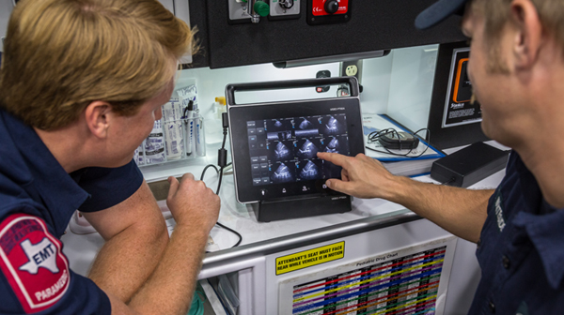
IRAP Scholarship
ImageTrend’s Path to Production:
Engaged via NEMSIS TAC in Path to Production – January ‘22
Attended Standards Acceleration Workshops in Atlanta, CAT22
Awarded IRAP/Bill Majurski Scholarship for Connectathon 2023
Notes:
IHE USA’s IRAP Scholarship in memory of Bill Majurski
https://www.iheusa.org/ihe-na-connectathon/scholarship
2023 Interoperability Showcase Vignette: https://www.youtube.com/watch?v=nhYx4emSkk4&list=PLGFNwETCTdKmebo31ZtHzrA-RRUCRLVqC&index=36

Slide 21

Connectathon 2024: Update
Timing: HIMSS24 – March 2024
Virtual Connectathon: Q1 to support Showcase
Face to Face Connectathon: Q3 2024
Planned Activities/ Testing Tracks
NEMSIS: EMS Projectathon
CDC: Occupational Data for Health
WHO/GDHP: International Patient Summary
Social Care with Gravity Project/Civitas
AI in Radiology Workflow
QHINS: National Network Connectivity
Notes:
Virtual Connectathon in Q1: prep for showcase and intro for new participants
F2F Connectathon Q3: Focused testing tracks to advance specific IHE Profiles and HL7 Implementation Guides

Slide 22
HIMSS Interoperability Showcase™
Orlando Convention Center
HIMSS24
Premier specialty exhibition that includes demonstration areas, educational theaters, a product marketplace, on-demand content and numerous networking opportunities
HIMSS participants include market suppliers, non-profit organizations, payers, providers, academia, HIEs, SDOs, consulting firms, and federal agencies
Approx. 70 unique digital solutions connecting & interacting in real-time
Addressing critical & timely topics such as sepsis, immunization management, and mental health
Our mission is to demonstrate the power of standards-based interoperability by showcasing systems exchanging and using data in real time to improve care, outcomes, experience and healthcare.
Notes:
A key component of interoperability and standards adoption is demonstrating the “Art of the Possible”

Slide 23
Previous Showcase Demonstrations
Collaboratively showcasing existing work and interoperable technical achievements.
360X Care Transitions for a COVID-19 Patient
AI Automation at the Edge
AI Enabled Workflow Transformation
Automated Situational Awareness Reporting
Healthcare Surveillance for Pandemic Response
Heart Transplant
Journey of a COVID-19 Patient
Managing Mental Health & Pain Management
Patient-Centered Care for Chronic Disease
Stop Sepsis: Alert & Workflow Management
The Calm Healing Environment
The Healthy Hospital
The Newborn Experience
Work, Cancer Care and Health Reporting
Notes:
The Showcase continues to evolve in its use cases, demonstrations, and participants. EMS could and should be a part of many demonstrations.
Interop Showcase videos: https://www.youtube.com/playlist?list=PLGFNwETCTdKmebo31ZtHzrA-RRUCRLVqC
https://www.youtube.com/watch?v=Q8ntMUi4aHE&list=PLGFNwETCTdKmebo31ZtHzrA-RRUCRLVqC&index=7&pp=iAQB
(newest videos later in the playlist)

Slide 24

360X Care Transitions for a COVID-19 Patient
Participating Organizations:
eClinicalWorks, Epic, MatrixCare, MedAllies, Netsmart, Nextgen, DirectTrust
The complex course for this patient, who survives a severe case of COVID-19, involves transitions across long-term acute care hospitalization, home health, ambulatory care (PCP and Specialists) and skilled nursing.
The efficiency and coordination of his complicated trajectory to recovery is optimized by CoP alerting, 360X enabled care transitions, FHIR scheduling and DaVinci payer prior authorization.
The standards used include C-CDA, HL7, Direct, FHIR and IHE.
Notes:
360x – Care Transitions – One of the biggest challenges in Interoperability

Slide 25

Automated Situational Awareness Reporting
Participating Organizations:
CDC, Cerner, Texas Health Services Authority
Using the HL7 Novel Epidemic Response FHIR IG, hospitals will have access to a vendor agnostic all-hazards information sharing protocol necessary to support bed and resource availability reporting.
This approach focuses on modern, automated, and non-intrusive methods to access hospital data in real-time during a disaster scenario.
Notes:
SANER – Implementation Guide
Has a section for EMS interoperability in progress

Slide 26

Healthcare Surveillance for Pandemic Response
Participating Organizations: CDC, Cerner, Epic, InductiveHealth Informatics
The ability to respond rapidly to a pandemic requires effective and efficient data sharing between healthcare and public health agencies.
This demonstration, about an essential worker who has contracted COVID-19, highlights how critical information can flow seamlessly between clinical care and public health to respond to a crisis.

Slide 27

Heart Transplant
Participating Organizations: Cerner, InnoVision Medical, Qvera
Michael has been fighting heart failure for several years and his cardiologist feels his only option is a heart transplant. She refers Michael to the transplant team as he waits in the hospital for a donor heart.
Michael is at the top of the transplant list and when a heart becomes available the team acts quickly to confirm the donor is appropriate and schedule surgery.
The surgery is a success and Michael recovers in the cardiac ICU and step-down floor as he gains strength and gets ready for his release from the hospital.
Throughout his journey Michael depends on the ability of his clinical team to rapidly communicate medical data.
The cardiologist sends data and images on his condition, the viability of the donated heart is quickly assessed with interoperable data transfer, and medical device connectivity in the OR, ICU and step-down floor assures his clinical team can quickly and easily monitor and document his care.
Notes:
Could start with a visit to the ED – or later in use case, leverage interfacility transport specs

Slide 28

Managing Mental Health & Pain Management
Participating Organizations: Cerner, NetSmart
Halley has extreme chronic pain and seeks drugs at various clinics in and near the university she attends.
Halley receives opioids and eventually overdoses and is rushed to the ED.
Her overdose is reported to Public Health. At discharge, her case is assigned to a case manager.
During outpatient treatment, Halley’s case is identified for a clinical trial giving her access to a mobile app that connects her to a broader care team to help her make informed decisions about her health.

Slide 29
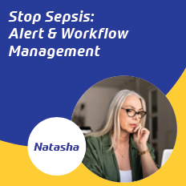
Stop Sepsis: Alert & Workflow Management
Participating Organizations: Epic, Luminare, Philips, Baxter Healthcare
Natasha, a 40-year-old Caucasian female presents to the ER of an academic medical center with indeterminate complaints of abdominal pain and malaise.
Routine labs and imaging were performed in the ER. Based on the results of tests, a CT abdomen was ordered.
The CT is reviewed while pulling priors and medications from different institutions. The report is sent back to EMR, and the physician pulls up images that show a perforated small intestine.
She had microbiology labs sent to Public Health and sepsis treatment protocol was implemented. The patient was transferred to the ICU and responded appropriately to treatment.
Notes:
Opportunities to add EMS to demonstration – and use that opportunity to talk about what works, what doesn’t, and influence policy and technical changes.

Slide 30
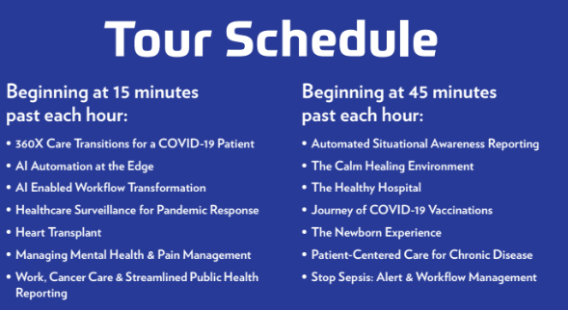
Demonstration Tours

Slide 31
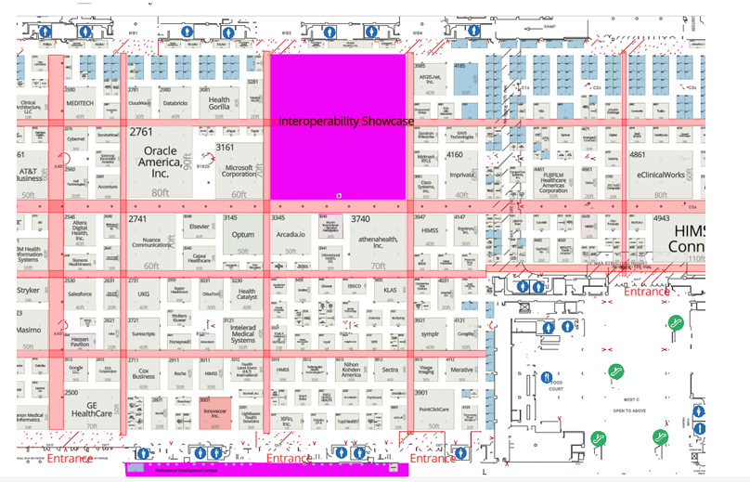
DRAFT Layout – HIMSS24 Global Conference Interoperability Showcase

Slide 32
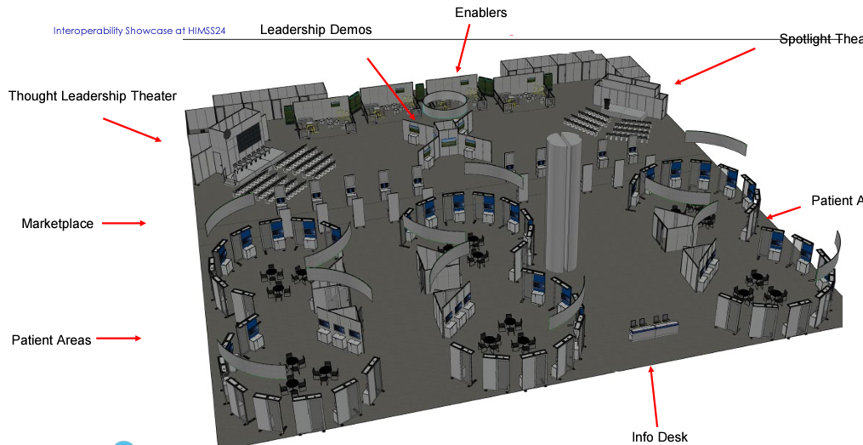
DRAFT Layout – HIMSS24 Interoperability Showcase

Slide 33
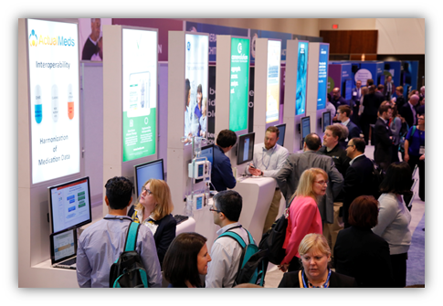
What’s new for Showcase @HIMSS24?
Central location in the heart of the HIMSS24 exhibition floor
Patient care continuum demonstration areas
Each with a persona, health condition, or problem to be solved in healthcare
Increased exposure to attendees
Foundational exhibitors in the hub of each patient area
Regularly scheduled full demo cohort presentations
Streamlined demonstration preparation process and milestones for vendor flexibility
New exhibitor levels for broader ecosystem involvement

Slide 34
Updated Participation Requirements
All demonstration participants must use an interoperability standard to exchange information (such as an HL7 Profile, IHE Profile, DICOM, DIRECT, etc.) and must submit an Interoperability Showcase Standards Attestation Form within two weeks of contracting with proof or planned validation of associated standards to be approved by the Technical Project Manager. The proof can be attestation, visual, or conformance/validation testing (such as participation and validation at an IHE Connectathon, a FHIR Connectathon, etc.). This validation acceptance process may be completed at an IHE Connectathon. No proprietary exchanges will be allowed in the demonstrations.
HIMSS24 Showcase Participants will undergo virtual testing approximately 8 weeks from the HIMSS24 Global Conference. Unsuccessful demonstrations will provide HIMSS with a roadmap for validation and are expected to attend a testing session during the IHE USA North American Connectathon or similar. O
Participation in planning meetings to prepare your demonstration are expected to start in November 2023.
Attendance at set up for one (1) day prior to HIMSS24 (8:00 am – 5:00 pm) and during all exhibition hours.

Slide 35
Timeline
Happening now: Patient Area themes development & first-come sign-up for participation, thought leadership session and exhibition spot
Starting November 2023: Demonstration partner planning meetings commence with participant technical representatives and Technical Project Managers. Meetings continue until conference
January 15, 2024: Deadline to commit with signed contract for inclusion in the printed show guide, print signs, walls and sponsor graphics
February 11, 2024: Deadline to be included in conference event page and mobile app
Monday, March 11th, 2024: Compulsory full-day (8:00 am – 5:00 pm) setup and rehearsal time onsite for connected technology demonstration participants and meeting at 11:00 am local time
Tuesday, March 12th, 2024 – Thursday, March 14th: Demonstrations with exchange partners during all exhibit floor hours and regularly during the day all Patient Area participant presentations.

Slide 36
Next Steps
HIMSS Interoperability Showcase Preparation – improve visibility of EMS in the interoperability ecosystem
Q1 2024 – Connectathon – Showcase prep - Virtual Event
Q3 2024 – IHE North American Connectathon - Face to Face Testing Event
Participate in the monthly NEMSIS EMS Interoperability Task Force Calls
Collaboratively update EMS Interoperability Whitepaper
Modernize and Advance the IHE PCS Profile from Trial Implementation
3 EMS stakeholders participate in Connectathon Testing
Prepare for ONC Annual Meeting / EMS Summit
Follow up with feedback – how else can we support interoperability within your organization?

Slide 37
Thank you!
Amit Trivedi, MS
Sr. Director, Health IT Standards and Informatics
Amit.Trivedi@himss.org

Slide 38
Current IO Landscape and Accomplishments

Slide 39
Accomplishments
IHE Connectathons
HIMSS Interoperability Showcase
Task Force
Repository and Wiki: github.com/IHE/EMS
Notes:
Review repo and wiki content.

Slide 40
Work in Progress
ONC letter/position statement
IHE Paramedicine Care Summary (PCS) profile updates
Sequence diagram updates
More outcome data in national EMS database
Notes:
Discuss importance/priority of each of these.
After the break, let’s figure out how to get them moving.
ONC letter: stuck in federal bureaucracy. Who should the letter be from and to? What tone and content is acceptable?
PCS: Josh proposed edits. Last draft was 2-1/2 years ago.
Sequence diagram updates: John Moehrke
Outcome data: some vendors are reviewing their integrations

Slide 41
Break

Slide 42
2024 Collaboration

Slide 43
Work in Progress
ONC letter/position statement
IHE Paramedicine Care Summary (PCS) profile updates
Sequence diagram updates
More outcome data in national EMS database
Notes:
Discuss how to get movement on each of these.
ONC letter: stuck in federal bureaucracy. Who should the letter be from and to? What tone and content is acceptable?
PCS: Josh proposed edits. Last draft was 2-1/2 years ago.
Sequence diagram updates: John Moehrke
Outcome data: some vendors are reviewing their integrations

Slide 44
Task Force
Monthly, 2nd Thursday, 11a–12:30p MT
Sep 14, Oct 12, Nov 9, Dec 14
Feb 16: Identifying data exchange partners and establishing relationships
Mar 9: Governmental, regulatory, and contractual environment
Apr 13: Regulatory environment and national networks recap
May 11: Sequence/workflow: SAFR design
Jun 8: Sequence/workflow
Jul 13: Standards and profiles overview
Specific standards and profiles to use in workflow:
Aug 10: EMS to Hospital
Hospital Outcomes to EMS
Patient History to EMS
Data elements to be shared and parsed
APIs
Patient identification and record matching

Slide 45
Potential Additional Products
White paper / implementation guide / toolkit
Data transformation resources
Sample data
National outcomes dashboard
Future workshops
Projectathon
Notes:
Ask if these resources would be helpful, and what else.
Data transformation resources would include a template for moving outcome data into a NEMSIS PCR.

Slide 46
Your Next Steps
Notes:
What about how to increase involvement in regulatory / public comment responses?
15 minutes for participants to share what they individually will work on next to improve EMS interoperability.

